Slide 1
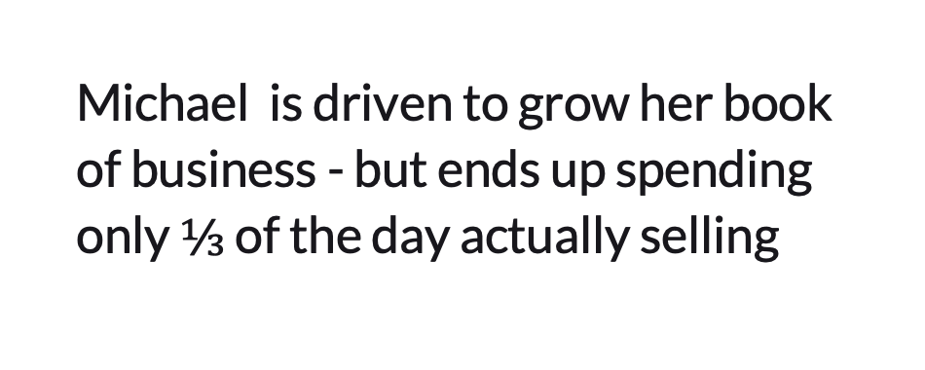
Hello!
Go-to-market plan template by Waveup. Before you start, install the free Lato font
Download it here:
Lato: https://fonts.google.com/specimen/Lato
To install:
Download the fonts, unzip, and copy them to your font folder.
Next, be sure to turn off Power Point and restart your computer.
Next, you need to make sure that the fonts are installed correctly. To do this, check the fonts in the presentation with these screenshots
* Template by Waveup · waveup.com/blog/go-to-market-strategy. If Lato doesn't show as in the screenshot, remove the font and install it again.
Notes:
Delete this slide before you share the plan.

Slide 2

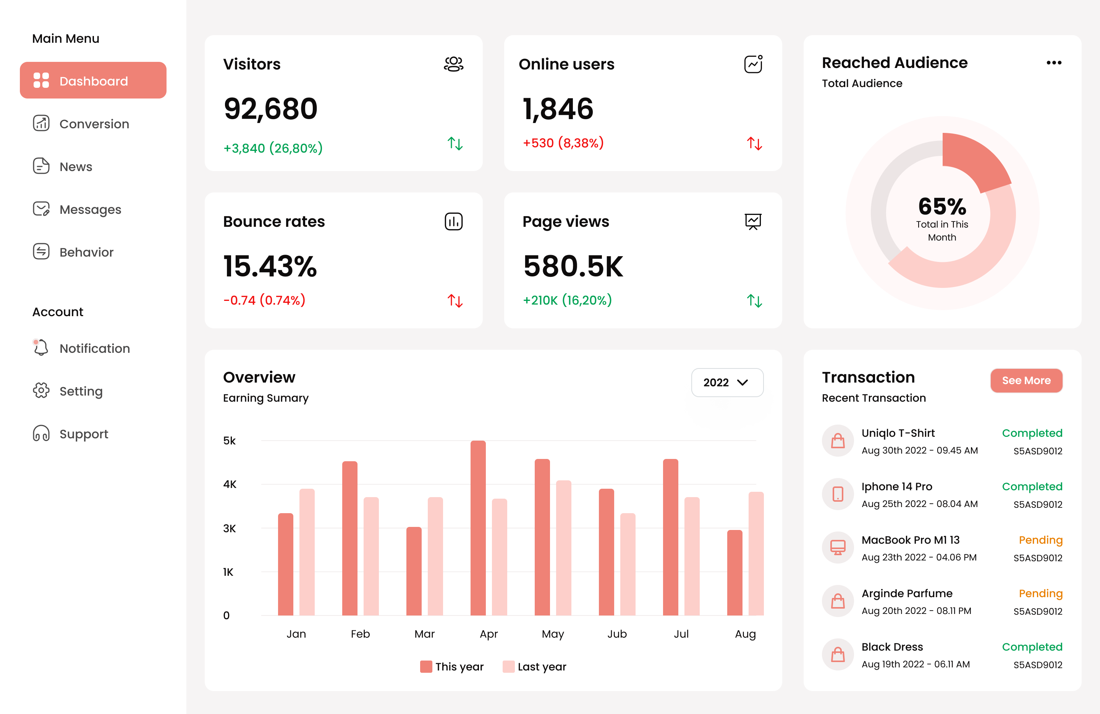
Go-to-market plan: [product] in [market]
Go-to-market plan
[Owner] · [Date]
Notes:
One product, one market and the first customers. Brand, content calendars and five-year visions live elsewhere.

Slide 3

Meet [your buyer]
Who buys, who uses it, and where to find them
[Their role]
Buyer: [role]
User: [role]
Company size: [range]
Place: [region]
[Type of company], [size], in [place]. Narrow enough to list 50 of them by name.
Uses today: [tool, agency or spreadsheet]
Where they gather: [events, groups, sites]
How they buy: [who signs, and the steps]
[COMPANY]
Notes:
Target customer. Could you list 50 of them by name? If not, narrow it.

Slide 4



[Who] loses [time / money] because [cause]
Problem
“
“
“
[What a customer told you, in their words]
[A second customer, in their words]
[A third customer, in their words]
[Role, type of company]
[Role, type of company]
[Role, type of company]
[COMPANY]
Notes:
Problem. Use the words customers use, not your pitch. Add what it costs them: about $[amount].

Slide 5
Our first market: [number] buyers × $[price]
First market
First market
Next markets
All buyers
$[__]
$[__]
$[__]
[Number] [buyers in the first segment] × $[price] a year
[Number] [buyers in the next segments] × $[price] a year
[Number] [buyers in total] × $[price] a year
[COMPANY]
Source: [where the counts come from]
Notes:
First market. Bottom-up first: buyers you can count, times your price. The big market number can wait.

Slide 6
For [customer] who [need], [product] is the [category] that [main benefit]
Unlike [the main alternative], it:
[Key difference 1]
[Key difference 2]
[Key difference 3]
[COMPANY]
Notes:
Positioning. The alternative is often a spreadsheet, an agency or nothing at all.

Slide 7


The price decides the sales motion you can afford
Pricing and sales motion
Pricing: $[price] per [unit]
Motion: [product / sales / partner]-led
Billed [monthly / yearly]. Free plan or trial: [yes / no, how long].
A buyer goes from [first touch] to [paying] in about [__] days.
[Plan 1: $__, for whom]
[Plan 2: $__, for whom]
[Plan 3: $__, for whom]
[Step 1: how they find you]
[Step 2: how they try it]
[Step 3: how they buy]
[COMPANY]
Notes:
Pricing and motion. A cheap product needs self-serve; a big contract can pay for a sales team. Mixing motions is fine. Say which one leads.

Slide 8
Two or three channels, each with an owner and a budget
Channels
01
02
03
04
00
00
00
[Channel 1]: [owner], $[__] a month
[Channel 2]: [owner], $[__] a month
[Channel 3]: [owner], $[__] a month
[What we won't do yet, and why]
[COMPANY]
Notes:
Channels. Two or three, not ten.

Slide 9
Pilot by [date], launch by [date]
Launch plan
Pilot starts
Launch
Team and budget
[Month]
[Month]
[Month]
[Month]
[Month]
$[__] for [__] months
Plan approved
Pilot list ready
[__] pilot customers
First review
Keep, fix or stop
Sales: [name]
Marketing: [name]
Onboarding: [name]
[COMPANY]
Notes:
Launch plan. Start in one segment or one region. Review it about 90 days after launch.

Slide 10



Targets, set before we spend the budget
Metrics
cc
c
Acquisition
Conversion
Retention
CAC: $[__]
CAC payback: [__] months
Win rate: [__]%
Activation: [event] in [__] days
Churn: [__]% a month
[Expansion or referral target]
[COMPANY]
Notes:
Metrics. Set the targets before you spend the budget, and give every number an owner.

Slide 11
We assume [__]
We'll test it by [how] before [date], and change the plan if [what we'd see].
Notes:
Risks and first test. Test the riskiest assumption first.
Before you launch, 12 checks: you can name 50 target customers; ten told you the problem in their words; you know what they use today; the price matches the motion; two or three channels, each with an owner and a budget; you know your activation event; CAC and payback targets are written down; the sales stages have expected days; pilot customers agreed to be references; website, demo and pricing page tell the same story; every number has an owner; a review date is set.

